Slide 1
Data collection, analysis and validation of data measurement
Board
Strategic
plan
Annual implementation plan
Development
Budget
Quality and safety
External
Ministry of health
Regione Liguria
Objectives of general directors
IF
PNE
CEO
Quarterly
to CdA
Monthly
to CEO

Slide 2
Coordination and integration of data
UNITS
Quality
Directions
Borad
Process/outcome data
E mail/call
Monthly meeting
Quality
UNITS
Directions
Borad
Intranet

Slide 3
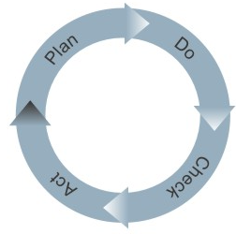


Quality system
Units
Quality and direction
Board
Annual quality plan
Proposals
Selection of
priorities
Approval and monitoring
Quality day
Best practices

Slide 4
Approved by department than by Medical Directione and Quality Service
Monitoring indicators and periodic review
Unique methodology approved by Quality Service consistent with international guidelines
Multi professional working groups
Diffusion
INTRANET
Pathways and
protocols
Prevention and control of hospital infections
Rehabilitation
Pathways of patients in emergency
Diagnosis and treatment of congenital malformations
Neonatal diseases
Hospitalwide priority
areas 2016

Slide 5
An example: screening for colonization by Enterobacteriacee or other GRAM negative bacteria resistant to Cabapenemi
Criteria selected to identify population at risk for CPE
Screening of the population at risk (rectal swab)
Preventive contact isolation,
protective measures
If the test result is positive …
Antibiotic suscettibility test
Recommendations
http://intranet.gaslini.lan/CCD/CIO
Patient known infected,
coming from abroad,
from other hospital, hospitalized over the last three months
,
Media europea
pesata sulla popolazione
8.1% (95%CI 8-9)
Higher costs per patient (20-25 €)
Organizational impact
Turn over
Income
Patient safety

Slide 6
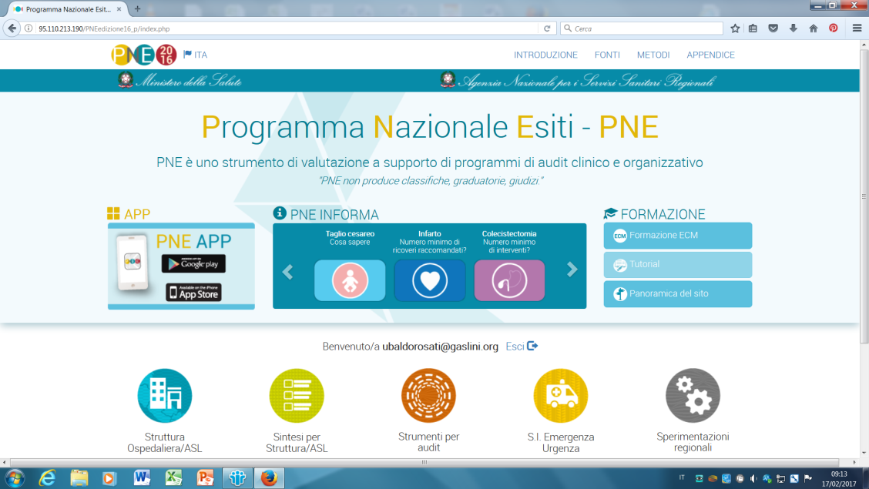
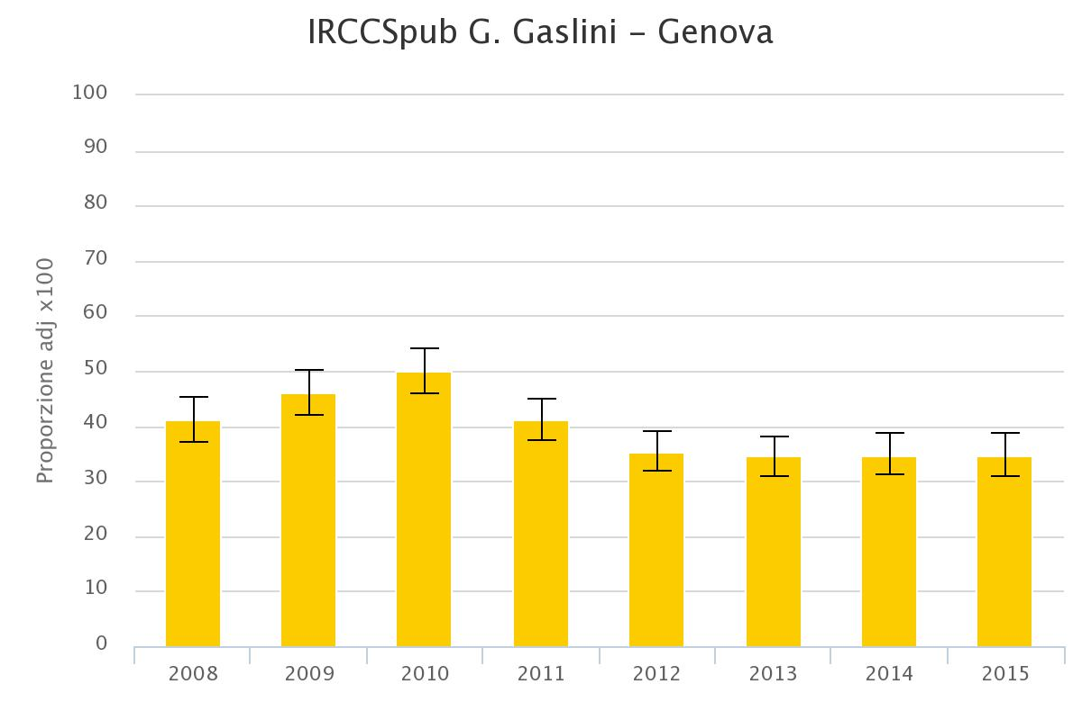
An example: reduction of caesarean section

Slide 7
Hospital leadership for contracts
Monthly monitoring with CEO
Quarterly report to board
Fire dept. service
Technical Service
Technical Service
Clinical Engineering
Purchaising dept.
Cleaning
Laundry
Purchaising dept
Medical Direction
Catering

Slide 8
Hospital leadership for quality and patient safety
IPSG 2.2
IPSG 3, 3.1
IPSG 5

Slide 9
Hospital leadership for quality and patient safety
Peri surgical mortality
Waiting time, radiology
Error and near miss
NEAR MISS |  | 1 ° TRIMESTRE |  |  | 2° TRIMESTRE |  |  | 3° TRIMESTRE |  | 4 ° TRIMESTRE
TIPOLOGIA | DESCRIZIONE EVENTO
 |  | MED | INF | ALTRO | MED | INF | ALTRO | MED | INF | MED | INF | ALTRO
ERRORE DI PRESCRIZIONE | Dosaggio/regime inappropriato |  | 1 | 3 | 1 |  | 1 | 1 | 1 |  |  | 1
 | dose errata x sottodosaggio |  |  |  |  | 2
ERRORE PREPARAZIONE / SOMMINISTRAZIONE | Diluizione o ricostituzione non corretta | 1
 | Scelta del farmaco sbagliato
ERRORE IN PROCEDURA TERAPEUTICA | prestazione assistenziale |  |  |  |  |  | 2
 | Inesattezza - distribuzione farmaco
 | Th scritta in grafica in modo errato ( o errore prescrizione????) |  |  |  |  | 1 |  |  |  |  | 1
ALTRO | Procedura informatica |  |  |  |  | 1
 | Cadute | 1
 | Dieta errata |  |  |  |  | 1
Post surgical sepsis

Slide 10
Prevalence 2013-2016
Europe ECDC 2011-2012; Lancet Infect Dis 2017

Slide 11
Antibiotics prescribed
30%

Slide 12
Patients
Health care professionals
Department
Governance
Management
Quality system
Patients

